Slide 1
CSE 6406: BIOINFORMATICS ALGORITHMS
CSE 463: INTRODUCTION TO BIOINFORMATICS
Motif finding problem

Slide 2
Random Sample
atgaccgggatactgataccgtatttggcctaggcgtacacattagataaacgtatgaagtacgttagactcggcgccgccg
acccctattttttgagcagatttagtgacctggaaaaaaaatttgagtacaaaacttttccgaatactgggcataaggtaca
tgagtatccctgggatgacttttgggaacactatagtgctctcccgatttttgaatatgtaggatcattcgccagggtccga
gctgagaattggatgaccttgtaagtgttttccacgcaatcgcgaaccaacgcggacccaaaggcaagaccgataaaggaga
tcccttttgcggtaatgtgccgggaggctggttacgtagggaagccctaacggacttaatggcccacttagtccacttatag
gtcaatcatgttcttgtgaatggatttttaactgagggcatagaccgcttggcgcacccaaattcagtgtgggcgagcgcaa
cggttttggcccttgttagaggcccccgtactgatggaaactttcaattatgagagagctaatctatcgcgtgcgtgttcat
aacttgagttggtttcgaaaatgctctggggcacatacaagaggagtcttccttatcagttaatgctgtatgacactatgta
ttggcccattggctaaaagcccaacttgacaaatggaagatagaatccttgcatttcaacgtatgccgaaccgaaagggaag
ctggtgagcaacgacagattcttacgtgcattagctcgcttccggggatctaatagcacgaagcttctgggtactgatagca

Slide 3
Implanting Motif AAAAAAAGGGGGGG
atgaccgggatactgatAAAAAAAAGGGGGGGggcgtacacattagataaacgtatgaagtacgttagactcggcgccgccg
acccctattttttgagcagatttagtgacctggaaaaaaaatttgagtacaaaacttttccgaataAAAAAAAAGGGGGGGa
tgagtatccctgggatgacttAAAAAAAAGGGGGGGtgctctcccgatttttgaatatgtaggatcattcgccagggtccga
gctgagaattggatgAAAAAAAAGGGGGGGtccacgcaatcgcgaaccaacgcggacccaaaggcaagaccgataaaggaga
tcccttttgcggtaatgtgccgggaggctggttacgtagggaagccctaacggacttaatAAAAAAAAGGGGGGGcttatag
gtcaatcatgttcttgtgaatggatttAAAAAAAAGGGGGGGgaccgcttggcgcacccaaattcagtgtgggcgagcgcaa
cggttttggcccttgttagaggcccccgtAAAAAAAAGGGGGGGcaattatgagagagctaatctatcgcgtgcgtgttcat
aacttgagttAAAAAAAAGGGGGGGctggggcacatacaagaggagtcttccttatcagttaatgctgtatgacactatgta
ttggcccattggctaaaagcccaacttgacaaatggaagatagaatccttgcatAAAAAAAAGGGGGGGaccgaaagggaag
ctggtgagcaacgacagattcttacgtgcattagctcgcttccggggatctaatagcacgaagcttAAAAAAAAGGGGGGGa

Slide 4
Where is the Implanted Motif?
atgaccgggatactgataaaaaaaagggggggggcgtacacattagataaacgtatgaagtacgttagactcggcgccgccg
acccctattttttgagcagatttagtgacctggaaaaaaaatttgagtacaaaacttttccgaataaaaaaaaaggggggga
tgagtatccctgggatgacttaaaaaaaagggggggtgctctcccgatttttgaatatgtaggatcattcgccagggtccga
gctgagaattggatgaaaaaaaagggggggtccacgcaatcgcgaaccaacgcggacccaaaggcaagaccgataaaggaga
tcccttttgcggtaatgtgccgggaggctggttacgtagggaagccctaacggacttaataaaaaaaagggggggcttatag
gtcaatcatgttcttgtgaatggatttaaaaaaaaggggggggaccgcttggcgcacccaaattcagtgtgggcgagcgcaa
cggttttggcccttgttagaggcccccgtaaaaaaaagggggggcaattatgagagagctaatctatcgcgtgcgtgttcat
aacttgagttaaaaaaaagggggggctggggcacatacaagaggagtcttccttatcagttaatgctgtatgacactatgta
ttggcccattggctaaaagcccaacttgacaaatggaagatagaatccttgcataaaaaaaagggggggaccgaaagggaag
ctggtgagcaacgacagattcttacgtgcattagctcgcttccggggatctaatagcacgaagcttaaaaaaaaggggggga

Slide 5
Implanting Motif AAAAAAGGGGGGG with Four Mutations
atgaccgggatactgatAgAAgAAAGGttGGGggcgtacacattagataaacgtatgaagtacgttagactcggcgccgccg
acccctattttttgagcagatttagtgacctggaaaaaaaatttgagtacaaaacttttccgaatacAAtAAAAcGGcGGGa
tgagtatccctgggatgacttAAAAtAAtGGaGtGGtgctctcccgatttttgaatatgtaggatcattcgccagggtccga
gctgagaattggatgcAAAAAAAGGGattGtccacgcaatcgcgaaccaacgcggacccaaaggcaagaccgataaaggaga
tcccttttgcggtaatgtgccgggaggctggttacgtagggaagccctaacggacttaatAtAAtAAAGGaaGGGcttatag
gtcaatcatgttcttgtgaatggatttAAcAAtAAGGGctGGgaccgcttggcgcacccaaattcagtgtgggcgagcgcaa
cggttttggcccttgttagaggcccccgtAtAAAcAAGGaGGGccaattatgagagagctaatctatcgcgtgcgtgttcat
aacttgagttAAAAAAtAGGGaGccctggggcacatacaagaggagtcttccttatcagttaatgctgtatgacactatgta
ttggcccattggctaaaagcccaacttgacaaatggaagatagaatccttgcatActAAAAAGGaGcGGaccgaaagggaag
ctggtgagcaacgacagattcttacgtgcattagctcgcttccggggatctaatagcacgaagcttActAAAAAGGaGcGGa

Slide 6
Where is the Motif???
atgaccgggatactgatagaagaaaggttgggggcgtacacattagataaacgtatgaagtacgttagactcggcgccgccg
acccctattttttgagcagatttagtgacctggaaaaaaaatttgagtacaaaacttttccgaatacaataaaacggcggga
tgagtatccctgggatgacttaaaataatggagtggtgctctcccgatttttgaatatgtaggatcattcgccagggtccga
gctgagaattggatgcaaaaaaagggattgtccacgcaatcgcgaaccaacgcggacccaaaggcaagaccgataaaggaga
tcccttttgcggtaatgtgccgggaggctggttacgtagggaagccctaacggacttaatataataaaggaagggcttatag
gtcaatcatgttcttgtgaatggatttaacaataagggctgggaccgcttggcgcacccaaattcagtgtgggcgagcgcaa
cggttttggcccttgttagaggcccccgtataaacaaggagggccaattatgagagagctaatctatcgcgtgcgtgttcat
aacttgagttaaaaaatagggagccctggggcacatacaagaggagtcttccttatcagttaatgctgtatgacactatgta
ttggcccattggctaaaagcccaacttgacaaatggaagatagaatccttgcatactaaaaaggagcggaccgaaagggaag
ctggtgagcaacgacagattcttacgtgcattagctcgcttccggggatctaatagcacgaagcttactaaaaaggagcgga

Slide 7
Why Finding (15,4) Motif is Difficult?
atgaccgggatactgatAgAAgAAAGGttGGGggcgtacacattagataaacgtatgaagtacgttagactcggcgccgccg
acccctattttttgagcagatttagtgacctggaaaaaaaatttgagtacaaaacttttccgaatacAAtAAAAcGGcGGGa
tgagtatccctgggatgacttAAAAtAAtGGaGtGGtgctctcccgatttttgaatatgtaggatcattcgccagggtccga
gctgagaattggatgcAAAAAAAGGGattGtccacgcaatcgcgaaccaacgcggacccaaaggcaagaccgataaaggaga
tcccttttgcggtaatgtgccgggaggctggttacgtagggaagccctaacggacttaatAtAAtAAAGGaaGGGcttatag
gtcaatcatgttcttgtgaatggatttAAcAAtAAGGGctGGgaccgcttggcgcacccaaattcagtgtgggcgagcgcaa
cggttttggcccttgttagaggcccccgtAtAAAcAAGGaGGGccaattatgagagagctaatctatcgcgtgcgtgttcat
aacttgagttAAAAAAtAGGGaGccctggggcacatacaagaggagtcttccttatcagttaatgctgtatgacactatgta
ttggcccattggctaaaagcccaacttgacaaatggaagatagaatccttgcatActAAAAAGGaGcGGaccgaaagggaag
ctggtgagcaacgacagattcttacgtgcattagctcgcttccggggatctaatagcacgaagcttActAAAAAGGaGcGGa
AgAAgAAAGGttGGG
..|..|||.|..|||
cAAtAAAAcGGcGGG

Slide 8
Challenge Problem
  Find a motif in a sample of
  - 20 “random” sequences (e.g. 600 nt long)
  - each sequence containing an implanted
  pattern of length 15,
  - each pattern appearing with 4 mismatches
  as (15,4)-motif.

Slide 9
Regulatory Regions
Every gene contains a regulatory region (RR) typically stretching 100-1000 bp upstream of the transcriptional start site
Located within the RR are the Transcription Factor Binding Sites (TFBS), also known as motifs, specific for a given transcription factor
TFs influence gene expression by binding to a specific location in the respective gene’s regulatory region - TFBS

Slide 10
Transcription Factor Binding Sites
A TFBS can be located anywhere within the
Regulatory Region.
TFBS may vary slightly across different regulatory regions since non-essential bases could mutate

Slide 11
Motifs and Transcriptional Start Sites
ATCCCG
gene
TTCCGG
gene
ATCCCG
gene
ATGCCG
gene
ATGCCC
gene

Slide 12
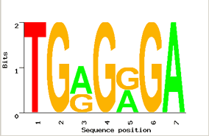
Motif Logo
TGGGGGA
TGAGAGA
TGGGGGA
TGAGAGA
TGAGGGA
Motifs can mutate on non important bases
The five motifs in five different genes have mutations in position 3 and 5
Representations called motif logos illustrate the conserved and variable regions of a motif

Slide 13
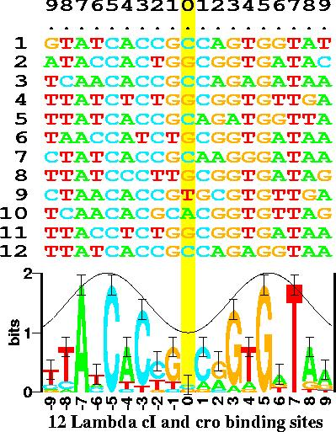
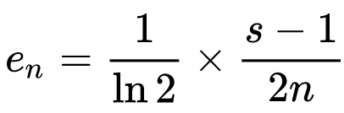
Motif Logos: An Example
Information content at position i
R_{i} = log₂(4) – (H_{i} + e_{n})
Where,
H_{i} = entropy at position i
e_{n} = small-sample correction
s → 4 for nucleotides, 20 for amino acids
n → the number of sequences in the alignment.
www-lmmb.ncifcrf.gov/~toms/sequencelogo.html
Notes:
s is 4 for nucleotides, 20 for amino acids, and {\displaystyle n} is the number of sequences in the alignment.

Slide 14
Identifying Motifs
Genes are turned on or off by regulatory proteins
These proteins bind to upstream regulatory regions of genes to either attract or block an RNA polymerase
Regulatory protein (TF) binds to a short DNA sequence called a motif (TFBS)
So finding the same motif in multiple genes’ regulatory regions suggests a regulatory relationship amongst those genes

Slide 15
Identifying Motifs: Complications
We do not know the motif sequence
We do not know where it is located relative to the genes start
Motifs can differ slightly from one gene to the next
How to discern it from “random” motifs?

Slide 16
The Motif Finding Problem
Given a random sample of DNA sequences:
  cctgatagacgctatctggctatccacgtacgtaggtcctctgtgcgaatctatgcgtttccaaccat
  agtactggtgtacatttgatacgtacgtacaccggcaacctgaaacaaacgctcagaaccagaagtgc
  aaacgtacgtgcaccctctttcttcgtggctctggccaacgagggctgatgtataagacgaaaatttt
  agcctccgatgtaagtcatagctgtaactattacctgccacccctattacatcttacgtacgtataca
  ctgttatacaacgcgtcatggcggggtatgcgttttggtcgtcgtacgctcgatcgttaacgtacgtc
Find the pattern that is implanted in each of the individual sequences, namely, the motif

Slide 17
The Motif Finding Problem (cont’d)
Additional information:
  The hidden sequence is of length 8
  The pattern is not exactly the same in each array because random point mutations may occur in the sequences

Slide 18
The Motif Finding Problem (cont’d)
The patterns revealed with no mutations:
  cctgatagacgctatctggctatccacgtacgtaggtcctctgtgcgaatctatgcgtttccaaccat
  agtactggtgtacatttgatacgtacgtacaccggcaacctgaaacaaacgctcagaaccagaagtgc
  aaacgtacgtgcaccctctttcttcgtggctctggccaacgagggctgatgtataagacgaaaatttt
  agcctccgatgtaagtcatagctgtaactattacctgccacccctattacatcttacgtacgtataca
  ctgttatacaacgcgtcatggcggggtatgcgttttggtcgtcgtacgctcgatcgttaacgtacgtc
  acgtacgt
  Consensus String

Slide 19
The Motif Finding Problem (cont’d)
The patterns with 2 point mutations:
  cctgatagacgctatctggctatccaGgtacTtaggtcctctgtgcgaatctatgcgtttccaaccat
  agtactggtgtacatttgatCcAtacgtacaccggcaacctgaaacaaacgctcagaaccagaagtgc
  aaacgtTAgtgcaccctctttcttcgtggctctggccaacgagggctgatgtataagacgaaaatttt
  agcctccgatgtaagtcatagctgtaactattacctgccacccctattacatcttacgtCcAtataca
  ctgttatacaacgcgtcatggcggggtatgcgttttggtcgtcgtacgctcgatcgttaCcgtacgGc

Slide 20
The Motif Finding Problem (cont’d)
The patterns with 2 point mutations:
  cctgatagacgctatctggctatccaGgtacTtaggtcctctgtgcgaatctatgcgtttccaaccat
  agtactggtgtacatttgatCcAtacgtacaccggcaacctgaaacaaacgctcagaaccagaagtgc
  aaacgtTAgtgcaccctctttcttcgtggctctggccaacgagggctgatgtataagacgaaaatttt
  agcctccgatgtaagtcatagctgtaactattacctgccacccctattacatcttacgtCcAtataca
  ctgttatacaacgcgtcatggcggggtatgcgttttggtcgtcgtacgctcgatcgttaCcgtacgGc
Can we still find the motif, now that we have 2 mutations?

Slide 21
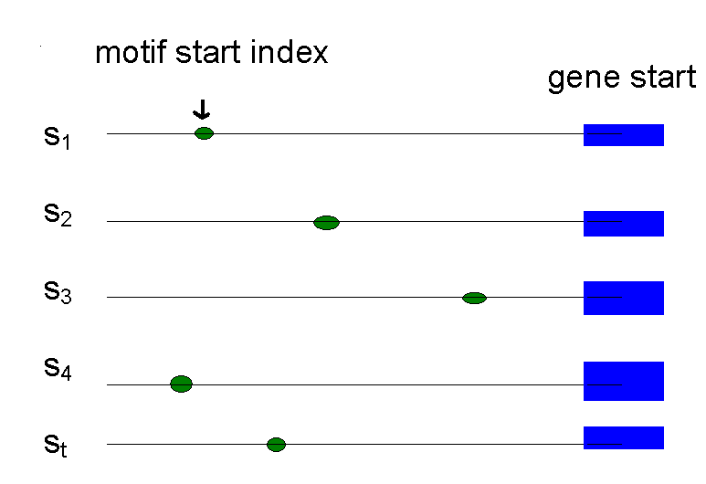
Defining Motifs
To define a motif, let us say we know where the motif starts in the sequence
The motif start positions in their sequences can be represented as s = (s₁,s₂,s₃,…,s_{t})

Slide 22
Motifs: Profiles and Consensus
  a G g t a c T t
  C c A t a c g t
  Alignment a c g t T A g t
  a c g t C c A t
  C c g t a c g G
  _________________
  A 3 0 1 0 3 1 1 0
  Profile C 2 4 0 0 1 4 0 0
  G 0 1 4 0 0 0 3 1
  T 0 0 0 5 1 0 1 4
  _________________
  Consensus A C G T A C G T
Line up the patterns by their start indexes
s = (s₁, s₂, …, s_{t})
Construct matrix profile with frequencies of each nucleotide in columns
Consensus nucleotide in each position has the highest score in column

Slide 23
Consensus
Think of consensus as an “ancestor” motif, from which mutated motifs emerged
The distance between a real motif and the consensus sequence is generally less than that for two real motifs

Slide 24
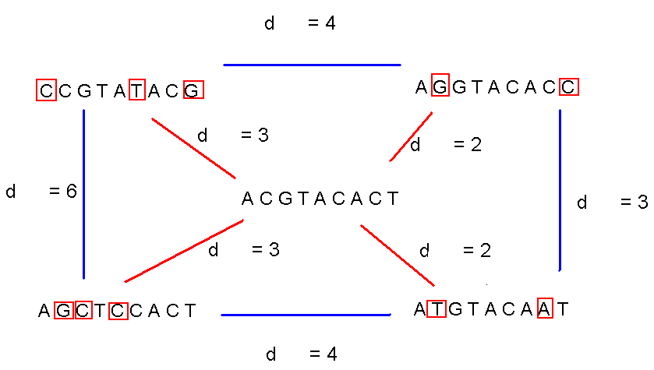
Consensus (cont’d)

Slide 25
Evaluating Motifs
We have a guess about the consensus sequence, but how “good” is this consensus?
Need to introduce a scoring function to compare different guesses and choose the “best” one.

Slide 26
Defining Some Terms
t - number of sample DNA sequences
n - length of each DNA sequence
DNA - sample of DNA sequences (t x n array)
l - length of the motif (l-mer)
s_{i} - starting position of an l-mer in sequence i
s=(s₁, s₂,… s_{t}) - array of motif’s starting positions

Slide 27
Parameters
  cctgatagacgctatctggctatccaGgtacTtaggtcctctgtgcgaatctatgcgtttccaaccat
  agtactggtgtacatttgatCcAtacgtacaccggcaacctgaaacaaacgctcagaaccagaagtgc
  aaacgtTAgtgcaccctctttcttcgtggctctggccaacgagggctgatgtataagacgaaaatttt
  agcctccgatgtaagtcatagctgtaactattacctgccacccctattacatcttacgtCcAtataca
  ctgttatacaacgcgtcatggcggggtatgcgttttggtcgtcgtacgctcgatcgttaCcgtacgGc
l = 8
DNA
t=5
n = 69
s
s₁ = 26 s₂ = 21 s₃= 3 s₄ = 56 s₅ = 60

Slide 28
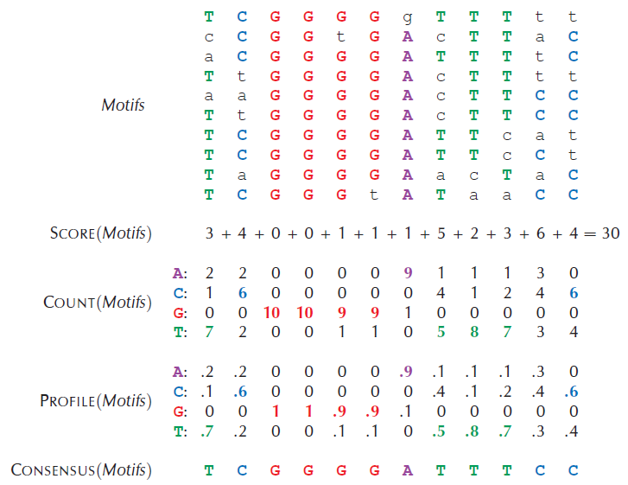
Scoring Motifs

Slide 29
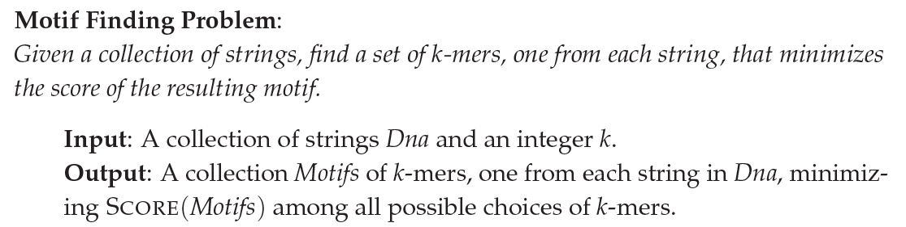
The Motif Finding Problem: Formulation

Slide 30
The Motif Finding Problem: Brute Force Solution
BruteForceMotifSearch(DNA, t, n, l)
bestScore ← 0
for each s = (s₁,s₂ , . . ., s_{t}) from (1,1 . . . 1)
to (n-l+1, . . ., n-l+1)
if (Score(s,DNA) < bestScore)
bestScore ← score(s, DNA)
bestMotif ← (s₁,s₂ , . . . , s_{t})
return bestMotif

Slide 31
Running Time of BruteForceMotifSearch
Varying (n - l + 1) positions in each of t sequences, we’re looking at (n - l + 1)^{t} sets of starting positions
For each set of starting positions, the scoring function makes l operations, so complexity is
l (n – l + 1)^{t} = O(l n^{t})
That means that for t = 8, n = 1000, l = 10 we must perform approximately 10²⁴ computations – it will take billions years

Slide 32
The Median String Problem
Given a set of t DNA sequences find a pattern that appears in all t sequences with the minimum number of mutations
This pattern will be the motif

Slide 33
Hamming Distance
Hamming distance:
  d_{H}(v, w) is the number of nucleotide pairs that do not match when v and w are aligned. For example:
d_{H}(AAAAAA, ACAAAC) = 2

Slide 34
Total Distance: An Example
Given v = “acgtacgt” and s
acgtacgt
  cctgatagacgctatctggctatccacgtacgtaggtcctctgtgcgaatctatgcgtttccaaccat
  acgtacgt
  agtactggtgtacatttgatacgtacgtacaccggcaacctgaaacaaacgctcagaaccagaagtgc
  acgtacgt
  aaacgtacgtgcaccctctttcttcgtggctctggccaacgagggctgatgtataagacgaaaatttt
  acgtacgt
  agcctccgatgtaagtcatagctgtaactattacctgccacccctattacatcttacgtacgtataca
  acgtacgt
  ctgttatacaacgcgtcatggcggggtatgcgttttggtcgtcgtacgctcgatcgttaacgtacgtc
v is the sequence in red, x is the sequence in blue
TotalDistance(v,DNA) = 0
d_{H}(v, x) = 0
d_{H}(v, x) = 0
d_{H}(v, x) = 0
d_{H}(v, x) = 0
d_{H}(v, x) = 0

Slide 35
Total Distance: Example
Given v = “acgtacgt” and s
acgtacgt
  cctgatagacgctatctggctatccacgtacAtaggtcctctgtgcgaatctatgcgtttccaaccat
  acgtacgt
  agtactggtgtacatttgatacgtacgtacaccggcaacctgaaacaaacgctcagaaccagaagtgc
  acgtacgt
  aaaAgtCcgtgcaccctctttcttcgtggctctggccaacgagggctgatgtataagacgaaaatttt
  acgtacgt
  agcctccgatgtaagtcatagctgtaactattacctgccacccctattacatcttacgtacgtataca
  acgtacgt
  ctgttatacaacgcgtcatggcggggtatgcgttttggtcgtcgtacgctcgatcgttaacgtaGgtc
v is the sequence in red, x is the sequence in blue
TotalDistance(v,DNA) = 1+0+2+0+1 = 4
d_{H}(v, x) = 1
d_{H}(v, x) = 0
d_{H}(v, x) = 2
d_{H}(v, x) = 0
d_{H}(v, x) = 1

Slide 36
Total Distance: Definition
  For each DNA sequence i, compute all d_{H}(v, x), where x is an l-mer with starting position s_{i}
  (1 < s_{i} < n – l + 1)
  Find minimum of d_{H}(v, x) among all l-mers in sequence i
  TotalDistance(v, DNA) is the sum of the minimum Hamming distances for each DNA sequence i
  TotalDistance(v, DNA) = min_{s} d_{H}(v, s), where s is the set of starting positions s₁, s₂,… s_{t}

Slide 37
The Median String Problem: Formulation
Goal: Given a set of DNA sequences, find a median string
Input: A t x n matrix DNA, and l, the length of the pattern to find
Output: A string v of l nucleotides that minimizes TotalDistance(v,DNA) over all strings of that length

Slide 38
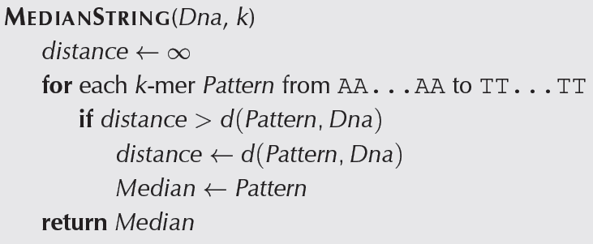
Median String Search Algorithm

Slide 39
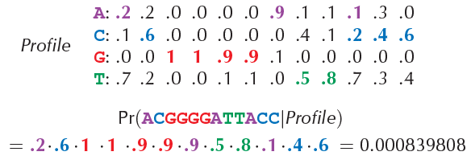
GREEDY MOTIF SEARCH
Select most probable motifs based on profile
Augment the profile
How is the profile generated initially?
How is the first motif chosen?

Slide 40
Scoring Strings with a Profile (cont’d)
Given a profile: P =
A | 1/2 | 7/8 | 3/8 | 0 | 1/8 | 0
C | 1/8 | 0 | 1/2 | 5/8 | 3/8 | 0
T | 1/8 | 1/8 | 0 | 0 | 1/4 | 7/8
G | 1/4 | 0 | 1/8 | 3/8 | 1/4 | 1/8
The probability of the consensus string:
Prob(aaacct|P) = ???

Slide 41
Scoring Strings with a Profile (cont’d)
Given a profile: P =
A | 1/2 | 7/8 | 3/8 | 0 | 1/8 | 0
C | 1/8 | 0 | 1/2 | 5/8 | 3/8 | 0
T | 1/8 | 1/8 | 0 | 0 | 1/4 | 7/8
G | 1/4 | 0 | 1/8 | 3/8 | 1/4 | 1/8
The probability of the consensus string:
Prob(aaacct|P) = 1/2 x 7/8 x 3/8 x 5/8 x 3/8 x 7/8 = .033646

Slide 42
Scoring Strings with a Profile (cont’d)
Given a profile: P =
A | 1/2 | 7/8 | 3/8 | 0 | 1/8 | 0
C | 1/8 | 0 | 1/2 | 5/8 | 3/8 | 0
T | 1/8 | 1/8 | 0 | 0 | 1/4 | 7/8
G | 1/4 | 0 | 1/8 | 3/8 | 1/4 | 1/8
The probability of the consensus string:
Prob(aaacct|P) = 1/2 x 7/8 x 3/8 x 5/8 x 3/8 x 7/8 = .033646
Probability of a different string:
Prob(atacag|P) = 1/2 x 1/8 x 3/8 x 5/8 x 1/8 x 1/8 = .001602

Slide 43
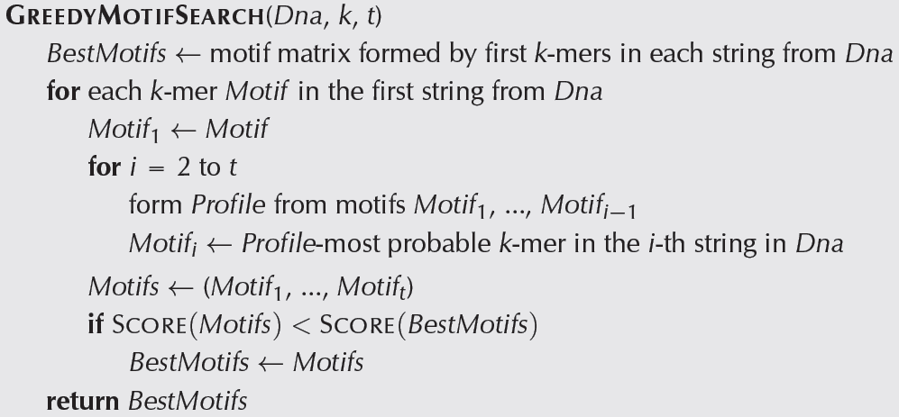
GREEDY MOTIF SEARCH

Slide 44
P-Most Probable l-mer
Define the P-most probable l-mer from a sequence as an l-mer in that sequence which has the highest probability of being created from the profile P.
A | 1/2 | 7/8 | 3/8 | 0 | 1/8 | 0
C | 1/8 | 0 | 1/2 | 5/8 | 3/8 | 0
T | 1/8 | 1/8 | 0 | 0 | 1/4 | 7/8
G | 1/4 | 0 | 1/8 | 3/8 | 1/4 | 1/8
P =
Given a sequence = ctataaaccttacatc, find the P-most probable l-mer

Slide 45
P-Most Probable l-mer (cont’d)
A | 1/2 | 7/8 | 3/8 | 0 | 1/8 | 0
C | 1/8 | 0 | 1/2 | 5/8 | 3/8 | 0
T | 1/8 | 1/8 | 0 | 0 | 1/4 | 7/8
G | 1/4 | 0 | 1/8 | 3/8 | 1/4 | 1/8
Find the Prob(a|P) of every possible 6-mer:
First try: c t a t a a a c c t t a c a t c
Second try: c t a t a a a c c t t a c a t c
Third try: c t a t a a a c c t t a c a t c
-Continue this process to evaluate every possible 6-mer

Slide 46
P-Most Probable l-mer (cont’d)
Compute prob(a|P) for every possible 6-mer:
String, Highlighted in Red | Calculations | prob(a|P)
ctataaaccttacat | 1/8 x 1/8 x 3/8 x 0 x 1/8 x 0 | 0
ctataaaccttacat | 1/2 x 7/8 x 0 x 0 x 1/8 x 0 | 0
ctataaaccttacat | 1/2 x 1/8 x 3/8 x 0 x 1/8 x 0 | 0
ctataaaccttacat | 1/8 x 7/8 x 3/8 x 0 x 3/8 x 0 | 0
ctataaaccttacat | 1/2 x 7/8 x 3/8 x 5/8 x 3/8 x 7/8 | .0336
ctataaaccttacat | 1/2 x 7/8 x 1/2 x 5/8 x 1/4 x 7/8 | .0299
ctataaaccttacat | 1/2 x 0 x 1/2 x 0 1/4 x 0 | 0
ctataaaccttacat | 1/8 x 0 x 0 x 0 x 0 x 1/8 x 0 | 0
ctataaaccttacat | 1/8 x 1/8 x 0 x 0 x 3/8 x 0 | 0
ctataaaccttacat | 1/8 x 1/8 x 3/8 x 5/8 x 1/8 x 7/8 | .0004

Slide 47
P-Most Probable l-mer (cont’d)
P-Most Probable 6-mer in the sequence is aaacct:
String, Highlighted in Red | Calculations | Prob(a|P)
ctataaaccttacat | 1/8 x 1/8 x 3/8 x 0 x 1/8 x 0 | 0
ctataaaccttacat | 1/2 x 7/8 x 0 x 0 x 1/8 x 0 | 0
ctataaaccttacat | 1/2 x 1/8 x 3/8 x 0 x 1/8 x 0 | 0
ctataaaccttacat | 1/8 x 7/8 x 3/8 x 0 x 3/8 x 0 | 0
ctataaaccttacat | 1/2 x 7/8 x 3/8 x 5/8 x 3/8 x 7/8 | .0336
ctataaaccttacat | 1/2 x 7/8 x 1/2 x 5/8 x 1/4 x 7/8 | .0299
ctataaaccttacat | 1/2 x 0 x 1/2 x 0 1/4 x 0 | 0
ctataaaccttacat | 1/8 x 0 x 0 x 0 x 0 x 1/8 x 0 | 0
ctataaaccttacat | 1/8 x 1/8 x 0 x 0 x 3/8 x 0 | 0
ctataaaccttacat | 1/8 x 1/8 x 3/8 x 5/8 x 1/8 x 7/8 | .0004

Slide 48
P-Most Probable l-mer (cont’d)
aaacct is the P-most probable 6-mer in:
ctataaaccttacatc
because Prob(aaacct|P) = .0336 is greater than the Prob(a|P) of any other 6-mer in the sequence.

Slide 49
Dealing with Zeroes
In our toy example prob(a|P)=0 in many cases. In practice, there will be enough sequences so that the number of elements in the profile with a frequency of zero is small.
To avoid many entries with prob(a|P)=0, there exist techniques to equate zero to a very small number so that one zero does not make the entire probability of a string zero (we will not address these techniques here).

Slide 50
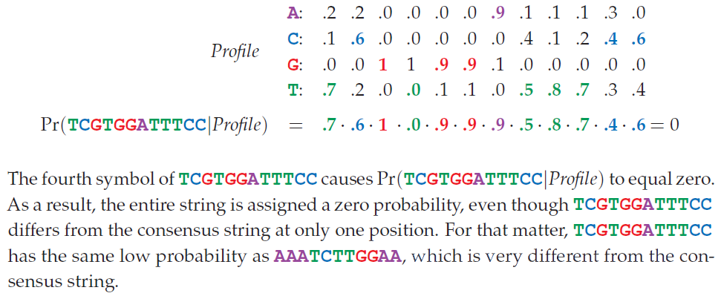
Dealing with Zeroes

Slide 51
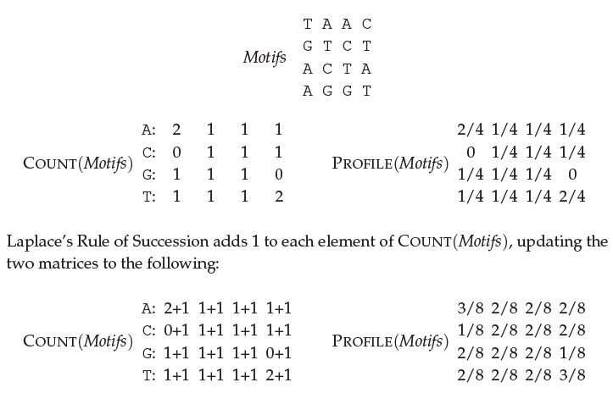
Laplace’s Rule of Succession

Slide 52
P-Most Probable l-mers in Many Sequences
Find the P-most probable l-mer in each of the sequences.
ctataaacgttacatc
atagcgattcgactg
cagcccagaaccct
cggtataccttacatc
tgcattcaatagctta
tatcctttccactcac
ctccaaatcctttaca
ggtcatcctttatcct
A | 1/2 | 7/8 | 3/8 | 0 | 1/8 | 0
C | 1/8 | 0 | 1/2 | 5/8 | 3/8 | 0
T | 1/8 | 1/8 | 0 | 0 | 1/4 | 7/8
G | 1/4 | 0 | 1/8 | 3/8 | 1/4 | 1/8
P=

Slide 53
P-Most Probable l-mers in Many Sequences (cont’d)
ctataaacgttacatc
atagcgattcgactg
cagcccagaaccct
cggtgaaccttacatc
tgcattcaatagctta
tgtcctgtccactcac
ctccaaatcctttaca
ggtctacctttatcct
1 | a | a | a | c | g | t
2 | a | t | a | g | c | g
3 | a | a | c | c | c | t
4 | g | a | a | c | c | t
5 | a | t | a | g | c | t
6 | g | a | c | c | t | g
7 | a | t | c | c | t | t
8 | t | a | c | c | t | t
A | 5/8 | 5/8 | 4/8 | 0 | 0 | 0
C | 0 | 0 | 4/8 | 6/8 | 4/8 | 0
T | 1/8 | 3/8 | 0 | 0 | 3/8 | 6/8
G | 2/8 | 0 | 0 | 2/8 | 1/8 | 2/8
P-Most Probable l-mers form a new profile

Slide 54
Comparing New and Old Profiles
1 | a | a | a | c | g | t
2 | a | t | a | g | c | g
3 | a | a | c | c | c | t
4 | g | a | a | c | c | t
5 | a | t | a | g | c | t
6 | g | a | c | c | t | g
7 | a | t | c | c | t | t
8 | t | a | c | c | t | t
A | 5/8 | 5/8 | 4/8 | 0 | 0 | 0
C | 0 | 0 | 4/8 | 6/8 | 4/8 | 0
T | 1/8 | 3/8 | 0 | 0 | 3/8 | 6/8
G | 2/8 | 0 | 0 | 2/8 | 1/8 | 2/8
A | 1/2 | 7/8 | 3/8 | 0 | 1/8 | 0
C | 1/8 | 0 | 1/2 | 5/8 | 3/8 | 0
T | 1/8 | 1/8 | 0 | 0 | 1/4 | 7/8
G | 1/4 | 0 | 1/8 | 3/8 | 1/4 | 1/8
Red – frequency increased, Blue – frequency descreased

Slide 55
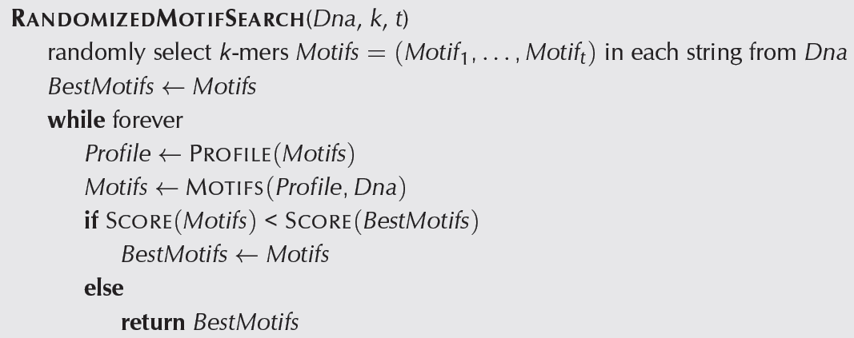
Randomized Motif Search

Slide 56
Randomized Motif Search
Since we choose starting positions randomly, there is little chance that our guess will be close to an optimal motif, meaning it will take a very long time to find the optimal motif.
It is unlikely that the random starting positions will lead us to the correct solution at all.
In practice, this algorithm is run many times with the hope that random starting positions will be close to the optimum solution simply by chance.

Slide 57
Gibbs Sampling
An iterative procedure that discards one l-mer after each iteration and replaces it with a new one.
Gibbs Sampling proceeds more slowly and chooses new l-mers at random increasing the odds that it will converge to the correct solution.

Slide 58
How Gibbs Sampling Works
1) Randomly choose starting positions
s = (s₁,...,s_{t}) and form the set of l-mers associated
with these starting positions.
2) Randomly choose one of the t sequences.
3) Create a profile P from the other t -1 sequences.
4) For each position in the removed sequence, calculate the probability that the l-mer starting at that position was generated by P.
5) Choose a new starting position for the removed sequence at random based on the probabilities calculated in step 4.
6) Repeat steps 2-5 until there is no improvement

Slide 59
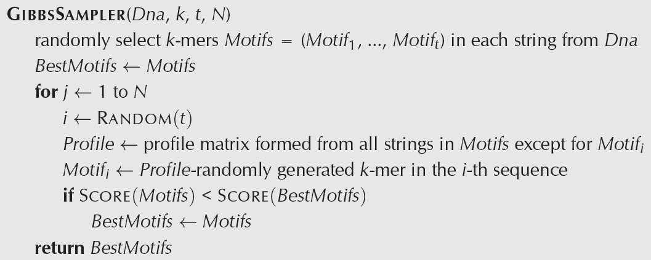
Gibbs Sampler

Slide 60
Gibbs Sampling: an Example
Input:
t = 5 sequences, motif length l = 8
1. GTAAACAATATTTATAGC
2. AAAATTTACCTCGCAAGG
3. CCGTACTGTCAAGCGTGG
4. TGAGTAAACGACGTCCCA
5. TACTTAACACCCTGTCAA

Slide 61
Gibbs Sampling: an Example
1) Randomly choose starting positions, s=(s₁,s₂,s₃,s₄,s₅) in the 5 sequences:
s₁=7 GTAAACAATATTTATAGC
s₂=11 AAAATTTACCTTAGAAGG
s₃=9 CCGTACTGTCAAGCGTGG
s₄=4 TGAGTAAACGACGTCCCA
s₅=1 TACTTAACACCCTGTCAA

Slide 62
Gibbs Sampling: an Example
2) Choose one of the sequences at random:
Sequence 2: AAAATTTACCTTAGAAGG
s₁=7 GTAAACAATATTTATAGC
s₂=11 AAAATTTACCTTAGAAGG
s₃=9 CCGTACTGTCAAGCGTGG
s₄=4 TGAGTAAACGACGTCCCA
s₅=1 TACTTAACACCCTGTCAA

Slide 63
Gibbs Sampling: an Example
2) Choose one of the sequences at random:
Sequence 2: AAAATTTACCTTAGAAGG
s₁=7 GTAAACAATATTTATAGC
s₃=9 CCGTACTGTCAAGCGTGG
s₄=4 TGAGTAAACGACGTCCCA
s₅=1 TACTTAACACCCTGTCAA

Slide 64
Gibbs Sampling: an Example
3) Create profile P from l-mers in remaining 4 sequences:
1 | A | A | T | A | T | T | T | A
3 | T | C | A | A | G | C | G | T
4 | G | T | A | A | A | C | G | A
5 | T | A | C | T | T | A | A | C
A | 1/4 | 2/4 | 2/4 | 3/4 | 1/4 | 1/4 | 1/4 | 2/4
C | 0 | 1/4 | 1/4 | 0 | 0 | 2/4 | 0 | 1/4
T | 2/4 | 1/4 | 1/4 | 1/4 | 2/4 | 1/4 | 1/4 | 1/4
G | 1/4 | 0 | 0 | 0 | 1/4 | 0 | 3/4 | 0
Consensus String | T | A | A | A | T | C | G | A

Slide 65
Gibbs Sampling: an Example
4) Calculate the prob(a|P) for every possible 8-mer in the removed sequence:
Strings Highlighted in Red prob(a|P)
AAAATTTACCTTAGAAGG | .000732
AAAATTTACCTTAGAAGG | .000122
AAAATTTACCTTAGAAGG | 0
AAAATTTACCTTAGAAGG | 0
AAAATTTACCTTAGAAGG | 0
AAAATTTACCTTAGAAGG | 0
AAAATTTACCTTAGAAGG | 0
AAAATTTACCTTAGAAGG | .000183
AAAATTTACCTTAGAAGG | 0
AAAATTTACCTTAGAAGG | 0
AAAATTTACCTTAGAAGG | 0

Slide 66
Gibbs Sampling: an Example
5) Create a distribution of probabilities of l-mers prob(a|P), and randomly select a new starting position based on this distribution.
a) To create this distribution, divide each probability prob(a|P) by the lowest probability:
Starting Position 1: prob( AAAATTTA | P ) = .000732 / .000122 = 6
Starting Position 2: prob( AAATTTAC | P ) = .000122 / .000122 = 1
Starting Position 8: prob( ACCTTAGA | P ) = .000183 / .000122 = 1.5
Ratio = 6 : 1 : 1.5

Slide 67
Turning Ratios into Probabilities
b) Define probabilities of starting positions according to computed ratios
Probability (Selecting Starting Position 1): 6/(6+1+1.5)= 0.706
Probability (Selecting Starting Position 2): 1/(6+1+1.5)= 0.118
Probability (Selecting Starting Position 8): 1.5/(6+1+1.5)=0.176

Slide 68
Gibbs Sampling: an Example
c) Select the start position according to computed ratios:
P(selecting starting position 1): .706
P(selecting starting position 2): .118
P(selecting starting position 8): .176

Slide 69
Gibbs Sampling: an Example
Assume we select the substring with the highest probability – then we are left with the following new substrings and starting positions.
s₁=7 GTAAACAATATTTATAGC
s₂=1 AAAATTTACCTCGCAAGG
s₃=9 CCGTACTGTCAAGCGTGG
s₄=5 TGAGTAATCGACGTCCCA
s₅=1 TACTTCACACCCTGTCAA

Slide 70
Gibbs Sampling: an Example
6) We iterate the procedure again with the above starting positions until we cannot improve the score any more.

Slide 71
Gibbs Sampler in Practice
Gibbs sampling needs to be modified when applied to samples with unequal distributions of nucleotides (relative entropy approach).
Gibbs sampling often converges to locally optimal motifs rather than globally optimal motifs.
Needs to be run with many randomly chosen seeds to achieve good results.

Slide 72
Thank you!

